Slide 1
Majlis Ansarullah Monthly Meeting
April 2019
This slide deck contains images licensed for the purpose of this presentation only.
No one is permitted to use the images for any other use, without prior permission.
Notes:
Changed date

Slide 2
AGENDA
Recitation of the Holy Qur’an (Verse 24:55)
Pledge
Did you know?
Sermon of the month: Attributes of True Ahmadi: Financial Sacrifice, obedience to Khilafat and Nizam-e-Jama'at (November 2, 2018)
Health Tip
Reminders/announcements
Du’a

Slide 3
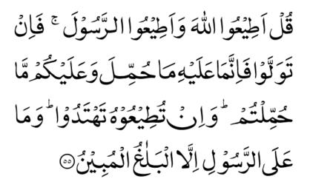
Recitation of the Holy Qur’an
[24:55] Say, ‘Obey Allah, and obey the Messenger.’ But if you turn away, then upon him is his burden, and upon you is your burden. And if you obey him, you will be rightly guided. And the messenger is not responsible but for the plain delivery of the Message.

Slide 4
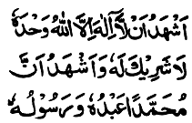
Ansar Pledge
Say this part three times:
Ash-hadu • alla ilaha • illallahu • wahdahu • la sharika lahu • wa ash-hadu • anna Muhammadan • ‘abduhu • wa rasuluh
Say this part once:
I bear witness • that there is none worthy of worship • except Allah. • He is One • (and) has no partner, • and I bear witness • that Muhammad (peace be upon him) • is His servant • and messenger.
Say this part once:
I solemnly pledge • that I shall endeavor • throughout my life • for the propagation • and consolidation • of Ahmadiyyat in Islam, • and shall stand guard • in defense of • the institution of Khilafat. • I shall not hesitate • to offer any sacrifice • in this regard. • Moreover, • I shall exhort my children • to always remain dedicated • and devoted • to Khilafat. • Insha’allah.

Slide 5
Did you know?
Za’im is in-charge of a local Majlis?
Nazim A’la is in-charge of a region consisting of a few Majalis.
Local Amila and National Amila are similar except in-charge of a department is called “Muntazim” in local Majlis Amila and is called “Qa’id” in national Majlis Amila.
Do you know various departments in Majlis Ansarullah?

Slide 6
Did you know?
Various Departments in National Majlis Amila
Sadr
Na’ib Sadr Awwal
Na’ib Sadr Saff Dom
Na’ib Sadran
Qa’id Umumi
Qa’id Ta’lim (Education)
Qa’id Tarbiyat (Moral Training)
Qa’id Tarbiyat Nau Muba’i’in
Qa’id Ithar
Qa’id Tabligh
Qa’id Dhahanat wa Sihat-i-Jismani
Qa’id Mal (Finance)
Qa’id Waqf Jadid
Qa’id Tahrik Jadid
Qa’id Tajnid
16. Qa’id Publications
17. Qa’id Ta’limul Qur’an
18. Auditor
19. Za’im A’al Muqami Region
20. Arakin-e-Khususi (honorary members)
21. Mu’awin Sadran (as needed)

Slide 7
Financial Sacrifice, obedience to Khilafat and Nizam-e-Jama'at Friday Sermon, November 2, 2018

Slide 8
Synopsis of the Sermon
1. Offering financial sacrifice is an instruction of Allah and the Holy Prophet (peace and blessings of Allah be on him). Promised Messiah (peace be on him) too, has drawn our attention towards this aspect of sacrifice. 2. The Jama’at has an established financial system. To reap Allah’s blessings, sufficient attention is needed in following this system. 3. Chanda payment is a matter between an individual and God Almighty. In the assessment of Chanda, one should remember that God Almighty has full knowledge of one’s earning. 4. The Holy Qur’an has commanded us to obey Allah and His Messenger (peace and blessings of Allah be on him), and also to show obedience to those who are in authority over us. 5. Obedience is one of the stipulations for taking the Bai’at. One has to pledge that they will obey every Ma’roof command, until their last breath. Whosoever does not show complete obedience seeks to malign this community. 6. Obedience requires a death on one’s part. Until one understands the reality of the pledge of allegiance, they cannot attain salvation.

Slide 9
Open Discussion Question
As a Nasir, which aspect of this Friday sermon, can I benefit the most from?
Share your thoughts!

Slide 10
Scenario 1
A well-off Nasir is approached by Jama’at’s Finance Secretary for his obligatory Chanda: “Please provide your budget for next year and please re-evaluate your budget carefully as your last year’s budget seemed low and did not reflect the income standard for your profession.” The Nasir told the Finance Secretary that Chanda is a matter between an individual and Allah the Almighty and the secretary should not interfere in his personal matters.

Slide 11
How would you respond?
The Nasir is correct and he should not be questioned. Whatever he chooses to pay should be accepted by the local Jama’at.
The Jama’at’s Finance Secretary is correct in admonishing the Nasir however, the approach could have been better.
The Jama’at’s Finance Secretary is justified in admonishing the Nasir and the Za’im should also admonish the Nasir regarding Ansar Chanda.
Any other response?

Slide 12
How would your response change if?
(Consider each separately.)
… The Nasir is an Amila member of the Jama’at.
… He gave a large donation to Humanity First last year.
… The Nasir has recently become more frequent in the Jama’at.
… The Nasir is your real brother.

Slide 13
Guidance from Friday Sermon
Another aspect which the Promised Messiah (peace be on him) has drawn our attention towards and which God Almighty and the Holy Prophet (peace and blessings of Allah be on him) have also instructed us to perform is financial sacrifices.
One should assess their income because the payment of Chanda is a matter between the individual and God Almighty. The administration or the Finance Secretary is not aware of what the Chanda-payers’ actual income is, however God Almighty has full knowledge of it.
Therefore, in view of this, everyone should assess their budgets again and revise their payments. Thus, all those people who – despite living in comfort do not pay their Chanda according to the prescribed rate – I would like to draw their attention towards this matter so that they can become the recipients of God’s blessings.

Slide 14
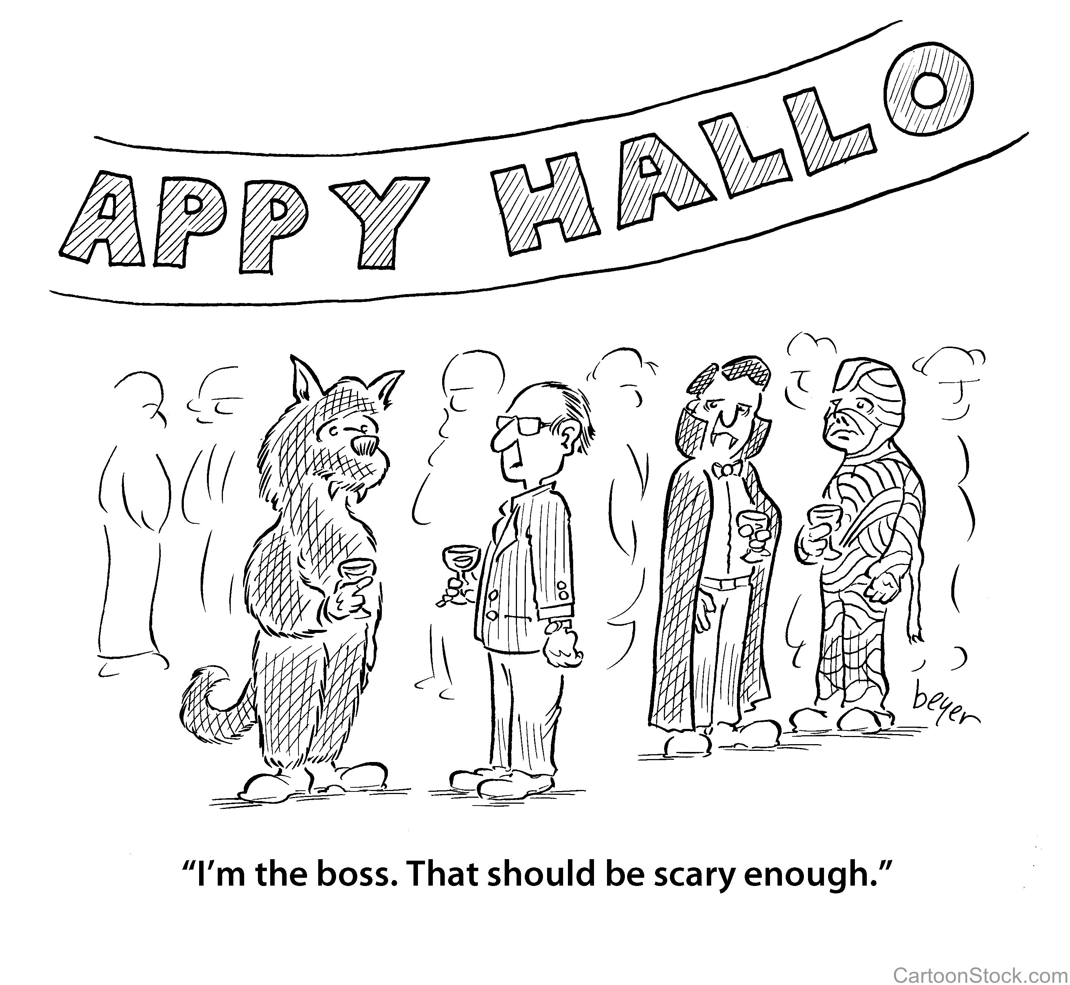
Scenario 2
A Nasir has always been a proponent for integration with Western society to disseminate the message of Islam. For example, he permits his children to take part in trick-or-treating and wearing costumes on Halloween. In a recent Friday sermon, the local Murabbi has reminded the members about Huzoor’s (may Allah be his helper) sermon regarding refraining from celebrating Halloween.

Slide 15
How would you respond?
Change his practice immediately and advise his kids against it as well.
Write a letter to Huzoor (may Allah be his helper) to explain that his purpose is ultimately to facilitate the spreading of the message of Islam.
Continue as-is until he feels at peace in his heart that he should change the practice.
Any other response?

Slide 16
How would your response change if?
(Consider each separately.)
… The Nasir’s wife is an American convert to Islam Ahmadiyyat.
… The Nasir has been very successful in bringing non-Ahmadi guests to the mosque.
… The Nasir is a member of the local Jama’at Amila.

Slide 17
Guidance from Friday Sermon
Furthermore, the Promised Messiah (peace be on him) has also included obedience as one of the stipulations for taking the Bai’at, and that is, for one to pledge that they will obey every Ma’roof command, until their last breath.
It is not the job of an individual to interpret what is meant by the word Ma’roof. A Ma’roof decision is one which is in line with the Holy Qur’an, the practice of the Holy Prophet (peace and blessings of Allah be on him) and his sayings, and also that which falls in line with the Just Arbitrator of this era—the Promised Messiah (may peace be on him). Through this, the unity of the Jama’at can be upheld.
The Promised Messiah (peace be on him) has clearly stated that it was not his desire to increase the number of followers with those who had no idea of what obedience entails. In this regard the Promised Messiah (peace be on him) states: “If those who affiliate themselves with me and enter into my Bai’at, yet fail to reform themselves and do not live their lives according to the teachings of God and His Messenger (peace and blessings of Allah be on him), then such a person’s Bai’at is futile.”

Slide 18
What to discuss with your family?
The importance of financial sacrifice as to how it purifies us.
Explain how Chanda is calculated and how these funds are
used in the Jama’at.
Importance of complete and unconditional obedience to Khilafat
and how it is the key to our survival as a community.
Tips to engage youth in conversation: (1) Give them more talking time, and (2) use examples from Huzoor’s (may Allah be his helper) sermon to make a point.

Slide 19
To-do list
Review your income and calculate the Chanda according to the prescribed rate.
Pay obligatory Chanda Jat (Chanda Aam and Chanda Jalsa Salana) monthly.
Make a pledge to obey each and every recommendation of Hazrat Khalifatul-Masih (may Allah be his helper), Insha’allah.

Slide 20
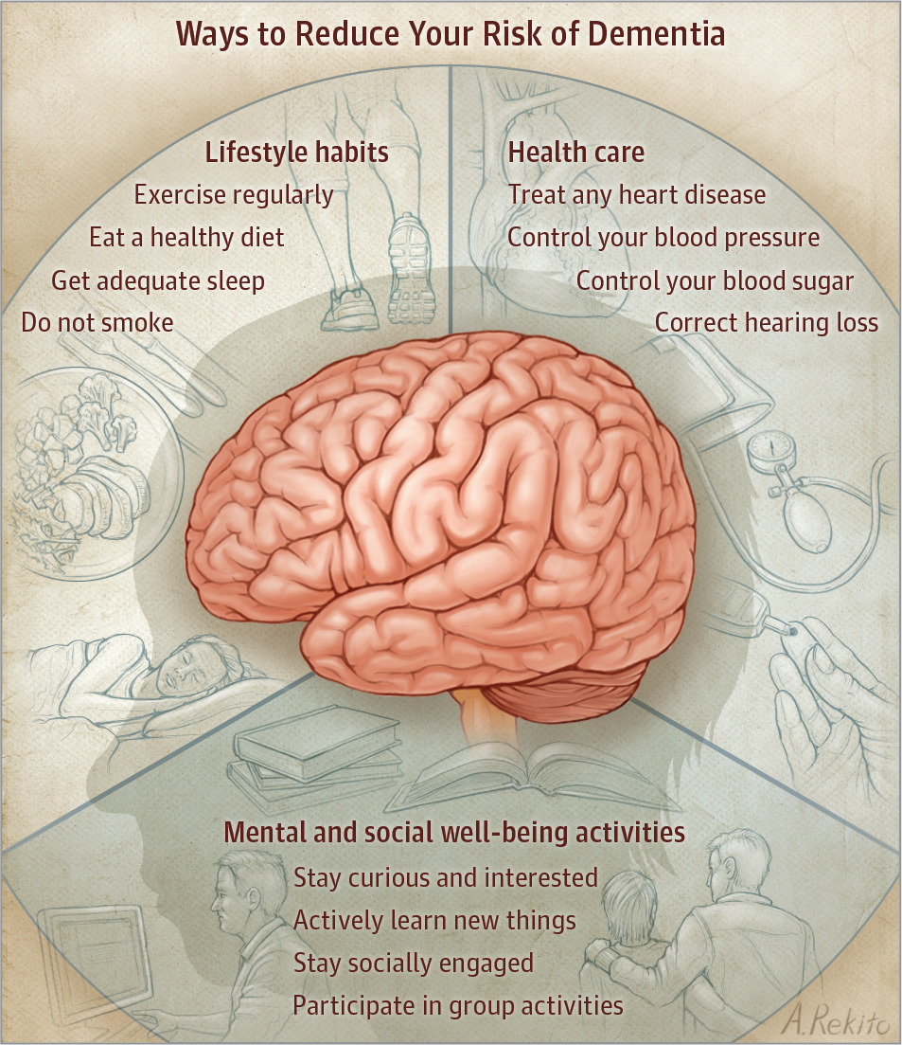
Health tip

Slide 21
How to prevent dementia?
Health tip
1-Life Style Habits
Increase physical activity. Regular exercise as simple as brisk walking for as little as 15 minutes a day protects brain structure and function.
Eat healthily. A Mediterranean diet consisting of fish, olive oil, non-starchy vegetables, and nuts has been related to lower risk of dementia.
Get a good night’s sleep. Adequate and uninterrupted sleep helps the brain repair itself.
Do not smoke. Smoking damages brain cells and vessels.

Slide 22
Health tip
2-Medical Conditions
Treat heart problems. Whatever is bad for the heart is bad for the brain. Treating heart problems may protect the brain.
Control blood pressure and blood sugar levels. Control of blood pressure and blood glucose (sugar) levels in midlife can improve brain health and may lower the risk of dementia in older age.
Protect the head. Wearing helmets and/or avoiding behaviors that increase the risk of head injury can decrease the risk of dementia.
Test hearing. Hearing loss is linked to dementia.

Slide 23
Health tip
3-Mental and Social Well being
Stay involved, curious, interested, and willing to learn new things. Being an active learner keeps the brain engaged and has beneficial effects on memory and information processing.
Stay socially engaged. Engagement in social activities including sports, cultural programs, and support groups has a positive effect on brain structure and function and is associated with a lower risk of dementia.

Slide 24
That’s all folks
Reminders/Announcements
Du’a
Jazakumullah for Participating!
If you enjoyed it, please convey to those brothers who are not here today!

