Slide 1

Majlis Ansārullāh
Monthly Meeting
May 2025
Winning the battle but loosing the war
Overcoming minor grievances

Slide 2
AGENDA
Recitation and translation of the Holy Quran
Pledge
Hadith
Discussion Segment
Salat (Daily Prayers)
Al–Wasiyyat
Zahanat
Reading The Holy Quran
Health segment
Local Time – Missionary Comments/Reminders/Announcements
Du’a

Slide 3
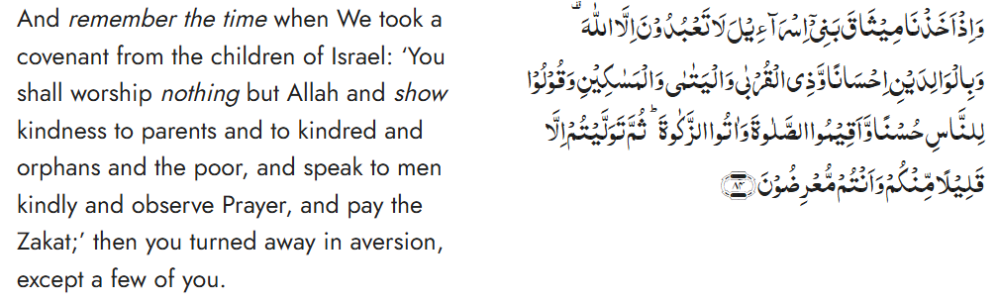
Recitation of the Holy Quran
Chapter 2, Al Baqarah, Verse 84

Slide 4
Pledge
Say this part three times:
Ash-hadu • alla ilaha • illallahu • wahdahu • la sharika lahu • wa ash-hadu • anna Muhammadan • ‘abduhu • wa rasuluh
Say this part once:
I bear witness • that there is none worthy of worship • except Allah. • He is One • (and) has no partner, • and I bear witness • that Muhammad (peace be upon him) • is His servant • and messenger.
Say this part once:
I solemnly promise that • I shall endeavor • till the end of my life • for the consolidation • and propagation of Islām Ahmadiyyat • and for upholding • the institution of Khilafat. • I shall also be prepared • to offer the greatest sacrifice • for this cause. • Moreover, • I shall urge all my children • to remain true • to Khilafat Ahmadiyya. • Insha’Allah.

Slide 5
Hadith

Slide 6
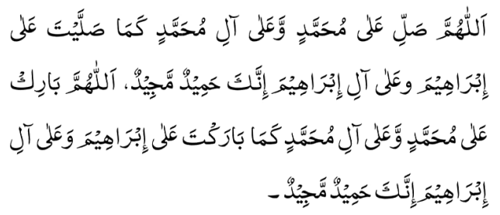
Hadith
O Allah, Bless Muhammad^{sa} and the people of Muhammad^{sa}, as Thou didst bless Abraham and the people of Abraham. Thou art indeed the Praiseworthy, the Glorious. Prosper, O Allah, Muhammad^{sa} and the people of Muhammad^{sa}, as Thou didst prosper Abraham and the people of Abraham. Thou are the Praiseworthy, the Glorious
Narrated by Hadrat Jarir bin Abdullah^{RA}: The Holy Prophet^{SA} said, "He who is not merciful to others, will not be treated mercifully”.
Sahih Bukhari
Narrated by Hadrat Abdullah ibn Amr ibn al-’As^{RA}: The Holy Prophet^{SA} said, “The Compassionate One has mercy on those who are merciful. If you show mercy to those who are on the earth, He Who is in the heaven will show mercy to you”.
Sunan Abi Dawud

Slide 7
The Holy Quran Discussion

Slide 8
Recitation of the Holy Quran
Chapter 2, Al Baqarah, Verse 84

Slide 9
Discussion
Two ladies got into a minor argument at the Masjid. One of the ladies mentioned it to her husband. He said that you should have responded harshly on the spot. Next week at a jama’at meeting this Nasir showed a cold shoulder to the husband of the other lady. On the way back, the other Nasir told his wife about the strange attitude. She said that they are an arrogant family. From then on, they started to avoid each other and were not on speaking terms anymore.
Do you agree with the advice of, “respond harshly on the spot”?
How would you have dealt with such a situation?
What can we learn from this scenario?

Slide 10
Five Volume Commentary
In this verse, as everywhere else in the Quran, the sequence of words follows the natural order of importance. The worship of the One God is mentioned first. Then mention is made of mankind, who have been divided into two classes: (1) those who deserve good treatment as a right; (2) those to whom kindness is shown as an act of charity. The first class is mentioned first, because in their case there is a sort of obligation, a debt to be paid. Those who are to be treated kindly out of charity are mentioned afterwards, the degree of need in each case determining the sequence. Last of all, acts of obedience to God are mentioned; and out of them the most important ones pertaining to the purification of the soul and the payment of religious taxes are selected; and these are placed after fellow feeling, because fellow feeling is the first step towards the moral elevation of man, who often feels impelled to it from within without reference to any law.

Slide 11
Speech by Hazrat Khalifatul Masih V^{aba}
Majlis Ansarullah UK Annual Ijtima 2024
In his address, Huzoor^{ABA} emphasized the need for patience and forgiveness within the Jama’at. He cited the teachings of the Promised Messiah^{AS} on the importance of developing tolerance and letting go of grievances.
Huzoor^{ABA} noted that holding grudges or escalating minor disagreements could lead to wider social discord and damage the unity of the Jama’at. Forgiveness, he explained, is a virtue that strengthens bonds and helps create a peaceful, harmonious environment, both within the family and in society at large.

Slide 12
خطبہ جمعہ 23؍ دسمبر 2005ء فرمودہ حضرت مرزا مسرور احمد، خلیفۃ المسیح الخامس ایدہ اللہ تعالیٰ بنصرہ العزیز
آپس میں محبت، پیار اور بھائی چارے کے تعلقات پیدا کریں
جلسہ سالانہ کا آغاز 1891ء میں اس چھوٹی سی بستی میں حضرت مسیح موعود علیہ الصلوٰۃ والسلام نے فرمایا تھا۔ اور اس کا مقصد اللہ اور اس کی مخلوق سے، اللہ تعالیٰ کے حکموں پر عمل کرنے والے لوگوں کا، مومنوں کا ایک تعلق جوڑنا تھا۔ اس جلسے کے مقاصد میں سے سب سے بڑا مقصد یہ باور کرانا تھا کہ اس دنیا کو ہی سب کچھ نہ سمجھو، یہ دنیا چند روزہ ہے، آخر کو انسان نے خدا کے حضور حاضر ہونا ہے اس لئے اپنی آخرت کی بھی فکر کرو، اپنے دل میں اللہ تعالیٰ کا خوف پیدا کرو۔ شیطان بہت سے دنیاوی لالچ دے گا لیکن اللہ تعالیٰ کا خوف دل میں رکھتے ہوئے، اللہ تعالیٰ سے اس کا فضل مانگتے ہوئے شیطان کے حملوں سے بچنے کی کوشش کرو۔ اپنے اندر زہد اور تقویٰ پیدا کرو۔ خدا ترسی کی عادت ڈالو۔ آپس میں محبت، پیار اور بھائی چارے کے تعلقات پیدا کرو۔ کیونکہ یہ آپس کے معاشرے کے تعلقات خداتعالیٰ کا خوف اور زہد و تقویٰ پیدا کرنے کے لئے بھی ضروری ہیں۔ اور اللہ تعالیٰ کا پیار حاصل کرنے کے لئے بھی ضروری ہیں۔ شیطان کے حملوں سے بچنا، اپنے بھائیوں کے حقوق ادا کرنا یہ سب چیزیں اُس وقت ہوں گی جب افراد جماعت عاجزی کے بھی اعلیٰ معیار قائم کر رہے ہوں گے اور سچائی کے بھی اعلیٰ معیار قائم ہوں گے اور دین کو دنیا پر مقدم رکھنے اور اس کے لئے اپنے آپ کو پیش کرنے کے بھی اعلیٰ معیار قائم ہوں گے۔ تو یہ ہے خلاصہ ان مقاصد کا جو حضرت مسیح موعود علیہ الصلوٰۃ والسلام جلسہ سالانہ منعقد کرکے حاصل کرنا چاہتے تھے۔ اور یہ مقاصد ہم اس وقت تک حاصل نہیں کر سکتے جب تک جیسا کہ مَیں نے پہلے بھی کہا تھا کہ اللہ تعالیٰ کا خوف دل میں پیدا نہیں ہوتا، اللہ تعالیٰ کے فضلوں کو سمیٹنے کی روح اور تڑپ پیدا نہیں ہوتی۔

Slide 13
Salat

Slide 14
Salat
Importance of salat
Friday Sermon delivered by Hazrat Khalifatul Masih V^{aba}
June 22nd, 2012
Huzoor^{ABA} elaborated on the importance of salat with focus on conditions of bai’at, the fact that it is a pillar of Islam and as it is highlighted in the Holy Quran. The third condition of bai’at lays emphasis on this fundamental commandment in these words: “That he/she shall regularly offer the five daily prayers in accordance with the commandments of God and the Holy Prophet (peace and blessings of Allah be upon him);”
Izala e Auham Roohani Khazain Volume 3, Page 564
Allah Almighty says: “Establish your prayer” many times throughout the Holy Quran. The Promised Messiah^{AS} says: “Man cannot attain nearness to Allah unless he performs prayers as it behooves to do so.”
Malfoozat Volume 2, Page 346, 2003 edition published Rabwah
In the context of the era we live in, the importance of offering salat increases more so because it is linked with the promise of Khilafat, which is a blessing for those who offer salat.
Salat should be offered in congregation, should be offered regularly, and should be offered on time. Allah Almighty says: “Establish prayer and give Zakat and prostrate with those who bow before God.”
(Chapter 2; Al Baqarah, Verse 44)
This verse emphasizes that offering prayer and making financial sacrifices take the best form when offered in congregation and as a community.
The Holy Prophet^{sa} has said that offering prayers in congregation increases the reward 27-fold.
Sahih Bukhari, Kitabus Salat 645

Slide 15
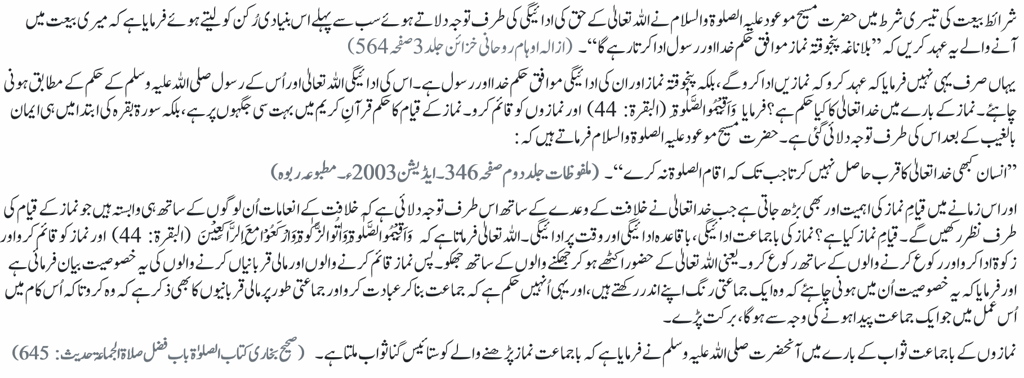
Salat
نماز کی اہمیت
خطبہ جمعہ 22؍ جون 2012ء
فرمودہ حضرت مرزا مسرور احمد، خلیفۃ المسیح الخامس ایدہ اللہ تعالیٰ بنصرہ العزیز

Slide 16
Al-Wasiyyat

Slide 17
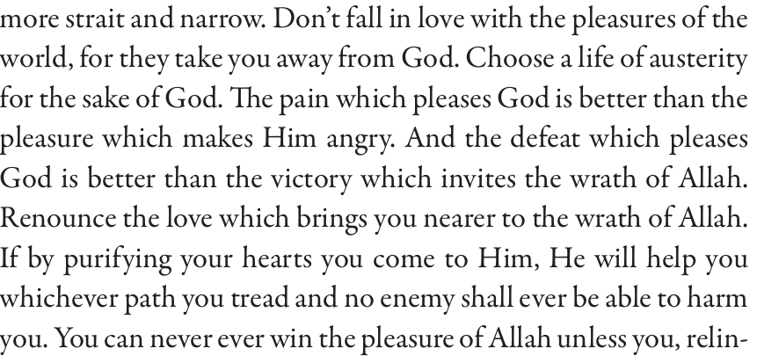
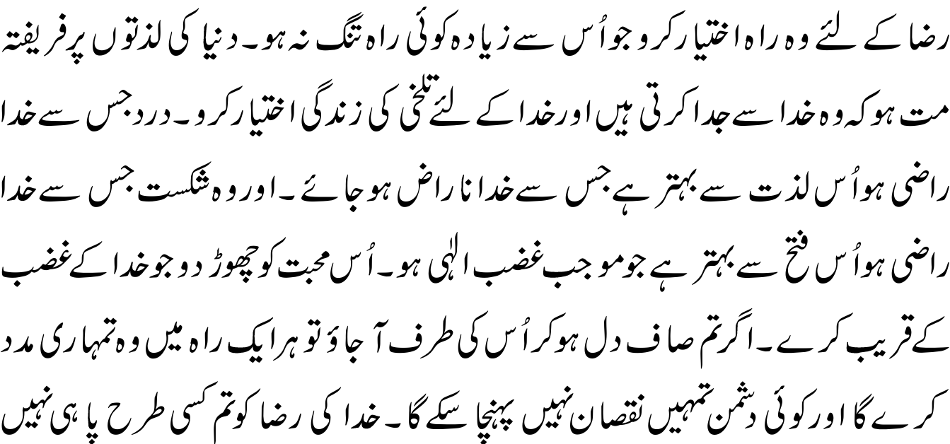
Al Wasiyyat
Al Wasiyyat

Slide 18
Zahanat
(Mental ability)

Slide 19
Zahanat
Q 1. How many zeroes are there in 1 million?
9
6
12
15
Q 2. What is the official language of Brazil?
Brazilian
Spanish
English
Portuguese
Q 3. There are true and false statements. It is a lie that this statement is false. True or False?
True
False

Slide 20
Zahanat
Q 1. How many zeroes are there in 1 million?
9
6
12
15
A million has 6 zeroes, while a billion has 9 zeroes, and a trillion has 12 zeroes.
Q 2. What is the official language of Brazil?
Brazilian
Spanish
English
Portuguese
Portuguese is the official and national language of Brazil, being widely spoken by nearly all of its population. Brazil is the most populous Portuguese-speaking country in the world, with its lands comprising the majority of Portugal's former colonial holdings in the Americas.
Q 3. There are true and false statements. It is a lie that this statement is false. True or False?
True
False

Slide 21
Reading of the Holy Quran

Slide 22
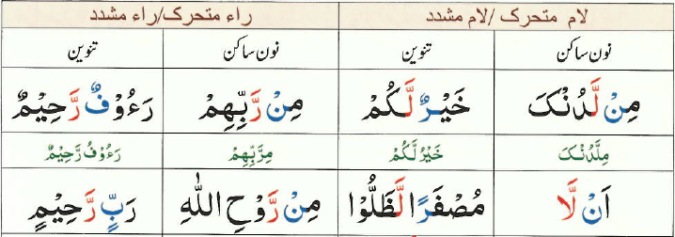

Quran Tajweed Basics
Rules of Nūn Sākin(ݩ) – Idghām(assimilation) without Gunnah
In Tajweed, Idgham means to merge one letter into another. If Nūn Sākin(ݩ) or Tanwīn is followed by Lām or Rā Mashaddad (رّ,لّ) then a complete Idgham without nasal sound is made. The Nūn and Tanwīn sounds should be completely eliminated.
See Ch:3 V9
A Common mistake while calling Azān: أَشْهَدُ أَن لَّا إِلَٰهَ إِلَّا ٱللَّٰهُ (Ash-hadu an la ilaha illa-llah)
Correct: (Ash-hadu alla ilaha illa-llah)
Play Audio
Or Click here

Slide 23
Health

Slide 24
Preventing High Blood Pressure
Tanvir Ahmed
Qaid Health

Slide 25

High Blood Pressure
More than half of Americans have High blood pressure.
It is called the silent killer, since many patients are not aware of their blood pressure
High Blood pressure is often asymptomatic but may have headache, chest pain, visual problems, swollen ankles etc.
High Blood pressure increases the risk of heart attack, stroke, kidney damage etc.
All of us should have at least an annual screening and more often depending on your risk factors.
Sadr Sahib has launched an initiative of "Annual Check up for all Ansar"

Slide 26
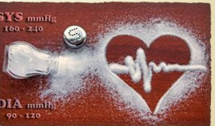

DIET
Decrease Salt intake - The single best dietary change is to reduce salt intake. Notorious sources are deli meats, fast foods, soda etc.
Fruits - Potassium (K+) is a key nutrient of healthy blood pressure. Fresh and dried fruits such as apricots, prunes, bananas, watermelon.
Vegetables are loaded with potassium and fiber. choices include potatoes (not french fries) beans, legumes, avocados, spinach, salads, lentils (Dal) etc.

Slide 27
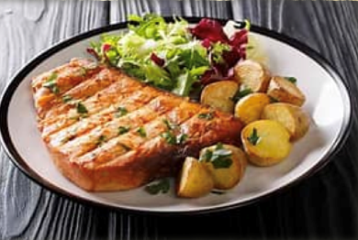
Low Fat, Fish, Vegetables and Fruits
Low Fat Dairy and dairy alternatives - Yogurt and Milk, Tofu, almonds etc.
Whole grains - provide magnesium, which relaxes blood vessels. Chose whole grain when choosing bread, cereal and pasta.
Fatty Fish -have DHA and EPA that reduce BP. All fish are good, but salmon, mackerel, anchovies, herring and sardines are the best for heart healthy fats.
Hydration - with water not sodas and sugar loaded drinks. Not even diet pops.

Slide 28
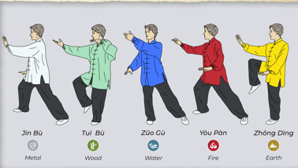
Lifestyle
Maintain a healthy weight - Even Modest weight loss of 5-10% can have significant benefits on blood pressure.
Exercise regularly - At least 150 minutes a week of moderate exercise.
Tai Chi was found to be better than Aerobic exercise for controlling blood pressure

Slide 29

Lifestyle
Stop smoking - There are no safe tobacco products. No cigs, cigars and Vape.
No Drugs No Alcohol.
Take your medicines as prescribed.
Follow up with your physician as advised.
Contact Qaid Health for any questions @ qaid.health@ansarusa.org

Slide 30
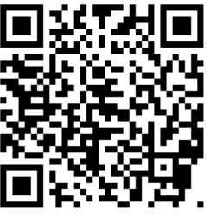
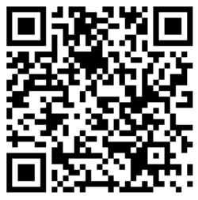
Local Majlis Time
Sign-up for TAQWA Quran classes via the following link
https://www.altaqwa.us/registration/
Sign-up for Waqf e Ardhi via the following link
https://tinyurl.com/WaqfeArdhiSignup
Murabbi Sahib’s Comments
Reminders/announcements
Du’a
Adjourn
Waqf e Ardhi Sign-up
Jazakumullah for Participating!
If you enjoyed it, please convey to those brothers who are not here today!
Please take a moment to provide your feedback
https://tinyurl.com/TalimDeckFeedback
Feedback

